Slide 1

GROUP number 03.
STUDENT NAME | REGISTRATION NUMBER
HAFIDH MWITA HAJI | BITAM/11/23/099/TZ
HALIMA AMEIR JUMA | BITAM/11/23/074/TZ
HARITH MAKAME | BITAM/11/23/059/TZ
HARITH OMAR | BITAM/11/23/056/TZ
HAFSA SAID ALI | BITAM/11/23/003/TZ
HEMED HUSSEIN PANDU | BITAM/11/23/032/TZ
HEMED SAID MMAKA | BITAM/11/23/001/TZ
IBRAHIM ASAA MO’HD | BITAM/11/23/073/TZ

Slide 2
PRIME HORIZON HOTEL
BACKGROUND
Prime Horizon Hotel is a prestigious 4-star luxury hotel located in the heart of Zanzibar, Tanzania. Established in 2015.
The hotel features include:
150 Rooms
3 Restaurants
2 Conference Halls
Wellness Center with massage and gym facilities
A Swimming Pool
24/7 Room Service
The hotel employs approximately 100 staff members across various departments

Slide 3
VISION AND MISSION
Vision
Being the premier 5-star hotel in Zanzibar, Tanzania, recognised for excellence in hospitality, innovation, and guest satisfaction.
Mission
To consistently deliver exceptional guest experiences by providing high-quality accommodation, outstanding customer service, and modern facilities, while creating value for our employees, partners, and the community.

Slide 4
BUSINESS PROCESSES
Reservation and Booking Process:
Guest Check-in Process
Housekeeping Process
Food and Beverage Service
Billing and Payment Process
Reporting and Management Process

Slide 5
EXISTING PROBLEMS
Double Booking Issues
Data Inconsistency and Errors
Inefficient Room Status Management
Delayed and Inaccurate Reporting
Revenue Leakage
Lack of Security and Data Backup
Poor Decision-Making Support

Slide 6
WHY WE NEED A DATABASE
Automation of Manual Processes
Centralised Data Storage
Real-Time Room Availability
Improved Revenue Management
Efficient Reporting and Decision-Making
Data Security and Backup
Competitive Advantage

Slide 7
SYSTEM USERS
System Administrator
General Manager
Front Desk Receptionists
Housekeeping Staff
Restaurant and Food & Beverage Staff
Finance and Accounting Staff
Guests

Slide 8
FUNCTIONAL REQUIREMENTS
Guest Management
Room Management
Reservation Management
Check-in and Check-out
Payment and Billing
Service Management
Reporting and Analytics
User Management and Security

Slide 9
NON-FUNCTIONAL REQUIREMENTS
Performance Requirements
Security Requirements
Reliability and Availability Requirements
Usability Requirements
Scalability Requirements
Maintenance and Support Requirements
Backup and Recovery Requirements

Slide 10
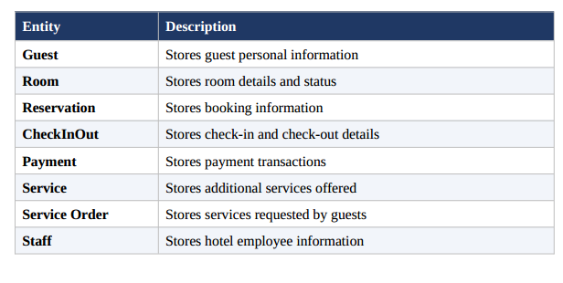
Database Design: Entities

Slide 11
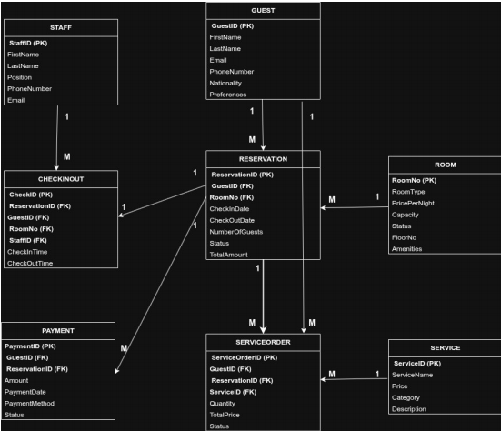
ERD

Slide 12
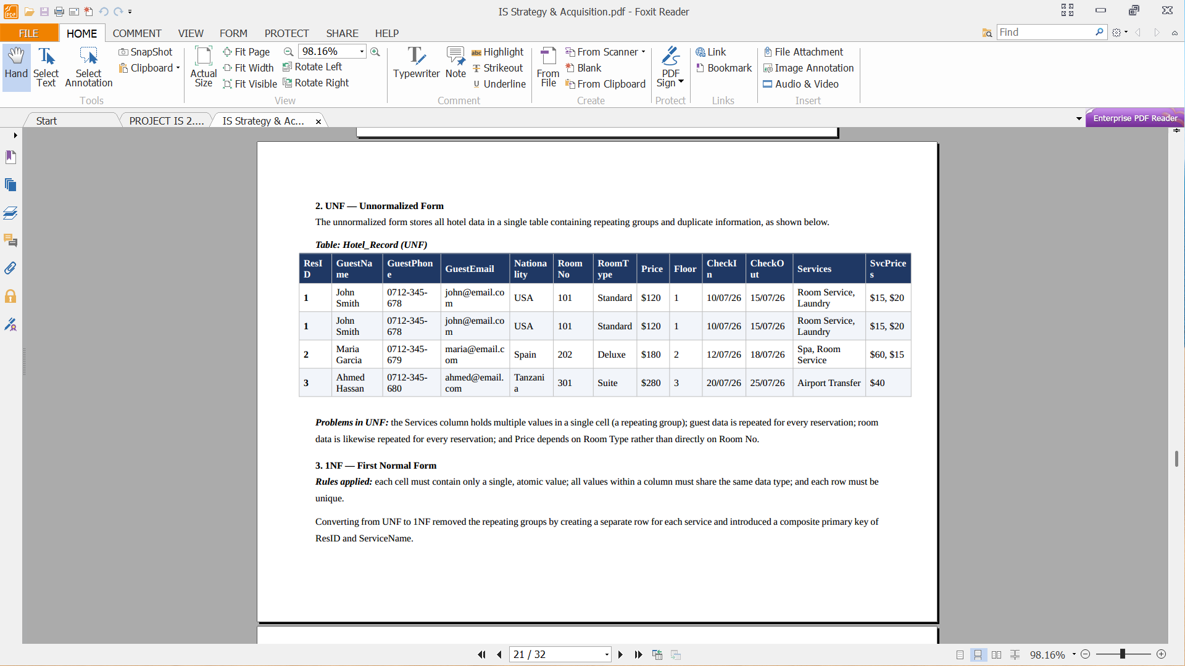
NORMALIZATION
This section demonstrates the normalization of the Prime Horizon Hotel database from unnormalized Form (UNF) through to Third Normal Form (3NF).
The goal is to ensure that the database design is efficient, consistent, and free from anomalies. Below is example for unnormalized form:

Slide 13
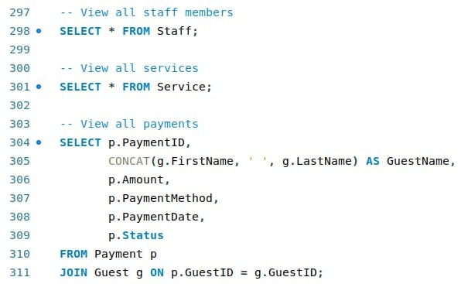
SQL Queries
Example outputs for Select query:

Slide 14
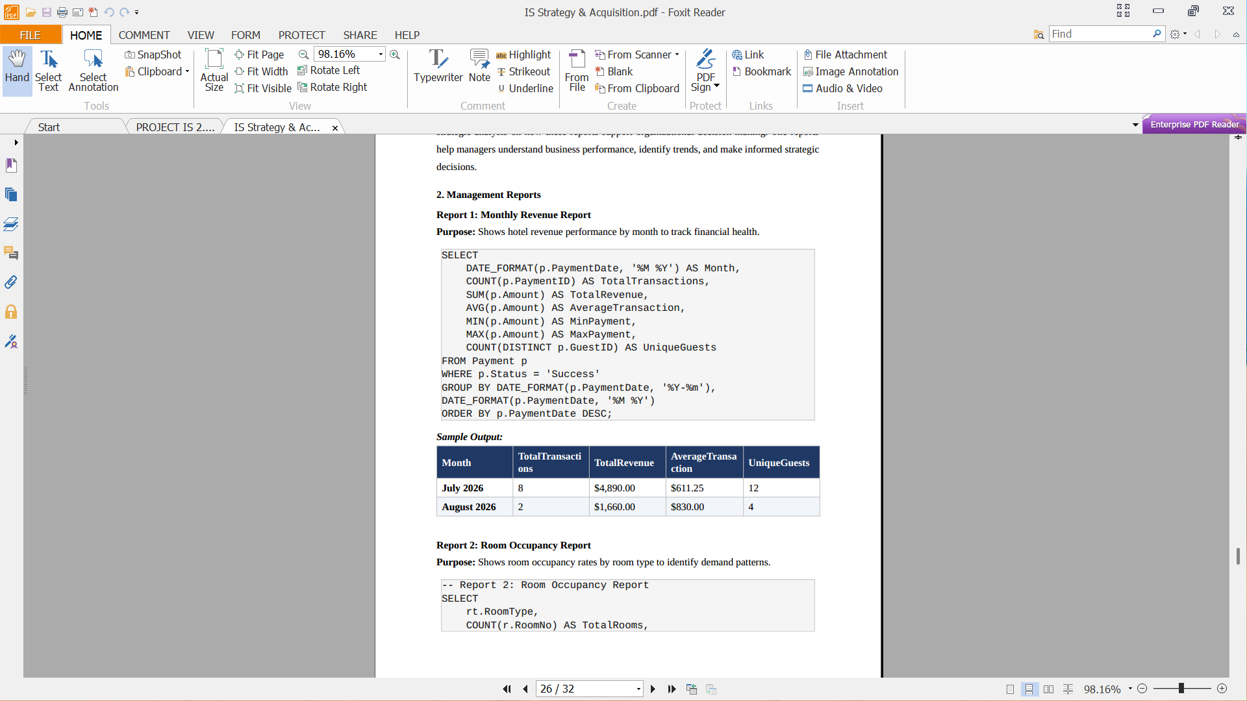
REPORTS AND STRATEGIC ANALYSIS

Slide 15
1) How these reports help management.
2) How the database supports organizational strategy.
Financial Management
Room Management
Guest Management
Service Management
Staff Management
Strategic Area | How the Database Supports It
Revenue Optimization | Tracks all income sources and identifies the highest revenue generators.
Cost Reduction | Identifies inefficiencies, such as empty rooms and low-demand services.
Guest Satisfaction | Stores guest preferences, enabling personalized service.
Competitive Advantage | Data-driven decisions help the hotel outperform competitors.
Marketing Effectiveness | Guest demographics guide targeted campaigns.
Operational Efficiency | Real-time data speeds up processes such as check-in and reservations.
Scalability | The database grows with the hotel and supports future expansion.

Slide 16
3) How managers can use the information for decision-making
1.Strategic Planning Decisions
2. Tactical Decisions
3. Operational Decisions
Data Source | Decision
Room occupancy | Adjust daily room prices (dynamic pricing).
Staff performance | Schedule staff based on occupancy projections.
Service revenue | Run promotions on underperforming services.
Data Source | Decision
Revenue reports | Set annual revenue targets and budgets.
Occupancy trends | Plan expansions or renovations during low seasons.
Guest demographics | Enter new markets or launch targeted campaigns.
Data Source | Decision
Daily operations | Allocate housekeeping based on check-in/out volume.
Payment methods | Offer discounts for preferred payment methods.
Service orders | Ensure popular services are always available.

Slide 17
THANK YOU

